Slide 1
Invente SHAI extension in VScode
OVH HackatHon – MARS 2026

Slide 2





Irritant
IA assistant in VS Code ready for everyone… except for us!
→
🤩
→
🤩
→
…
😢

Slide 3
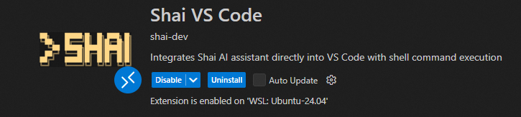
Our Goal
Set up VS Code with an AI extension dedicated to OVH: SHAI

Slide 4






The Super Crew
Samuel Lepetre CHAIR - Strategy intelligence
Dominique Pinchon CIO O2C – Sales Operations
Gwennin Gwassen CIO O2C – Billing
François Fleury CIO O2C - Sales Operations
Delphine Deillon CIO O2C - Sales Operations

Slide 5
Context
SHAI is a cutting-edge, terminal-based AI assistant designed to simplify your day-to-day development tasks.
SHAI can be integrated as a VS Code extension, directly into your editor with a chat interface.
Features Chat Interface: Interactive chat panel in VS Code sidebar
Shell Integration: Executes Shai AI commands directly through your system shell
Workspace Aware: Runs commands in your current workspace context
Customizable: Configure the Shai command path in settings
Opensource, available in Github

Slide 6
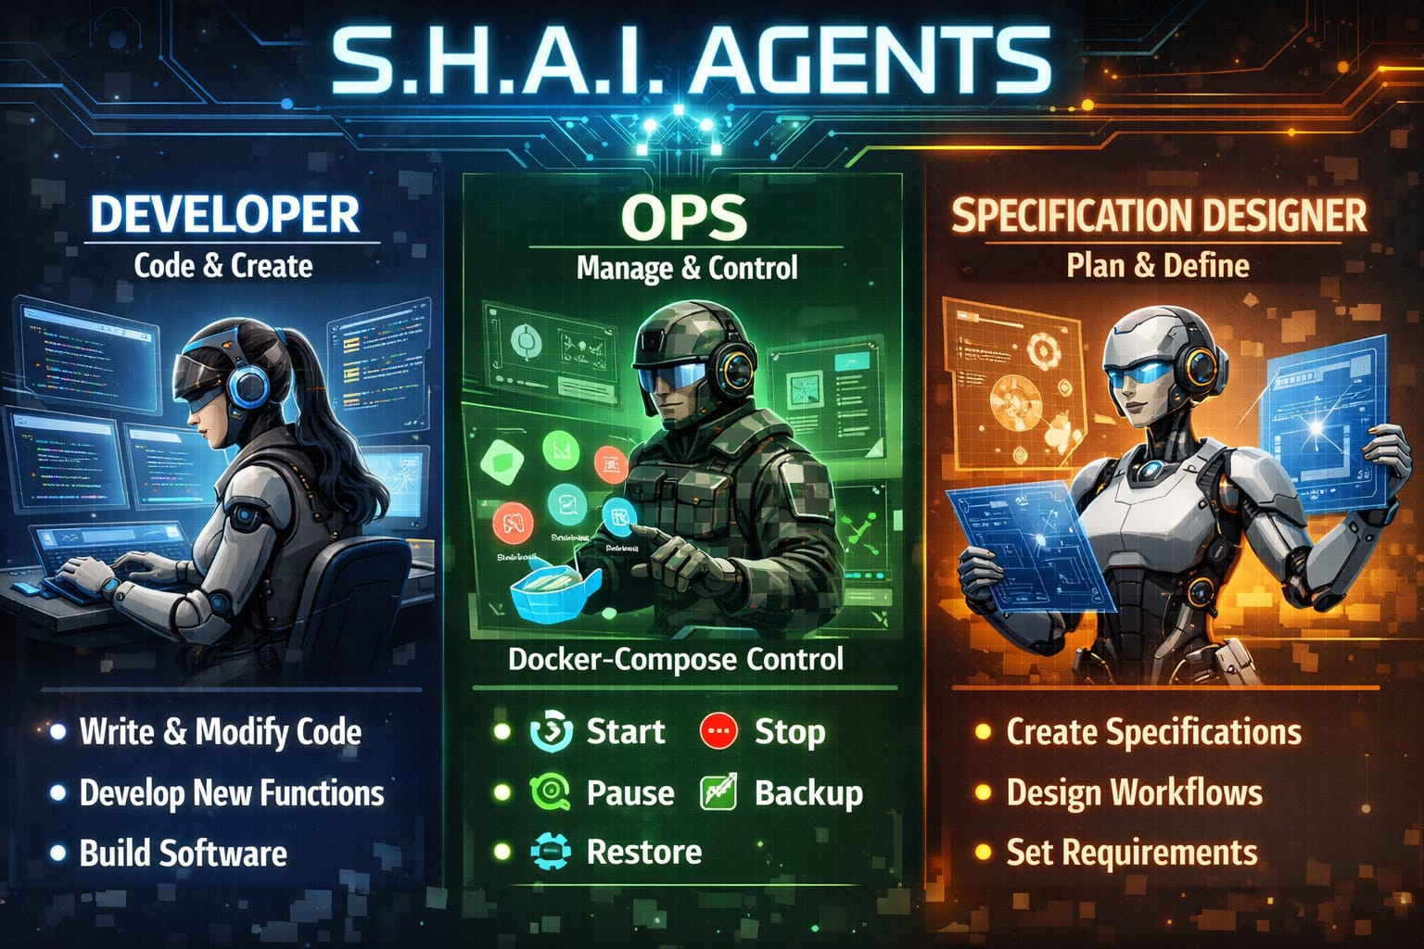
Roadmap

Slide 7
Our actions
# | Actions | Status
1 | Bug fix duplication of the answers by Shai to user requests | ✅
2 | Modify the context sent to Shai in order to formalize the answer so that VSCode tooling extension is converted into buttons for the user | ✅
3 | Validate the panel that display the way the LLM is dealing with the request (only few LLM models propose this kind of feature) | ✅
4 | Add a panel in multi tabbed notebook area to implement mechanism of generating specification (see kiro) | ✅
5 | Add a panel in multi tabbed notebook area to implement mechanism of generating devops agent | ✅
6 | Update the readme.md based on latests modifications | ✅
7 | Add PFR.md to follow-up the features | ✅
8 | Demo video | 🚧
9 | Prepare pitch | ✅

Slide 8

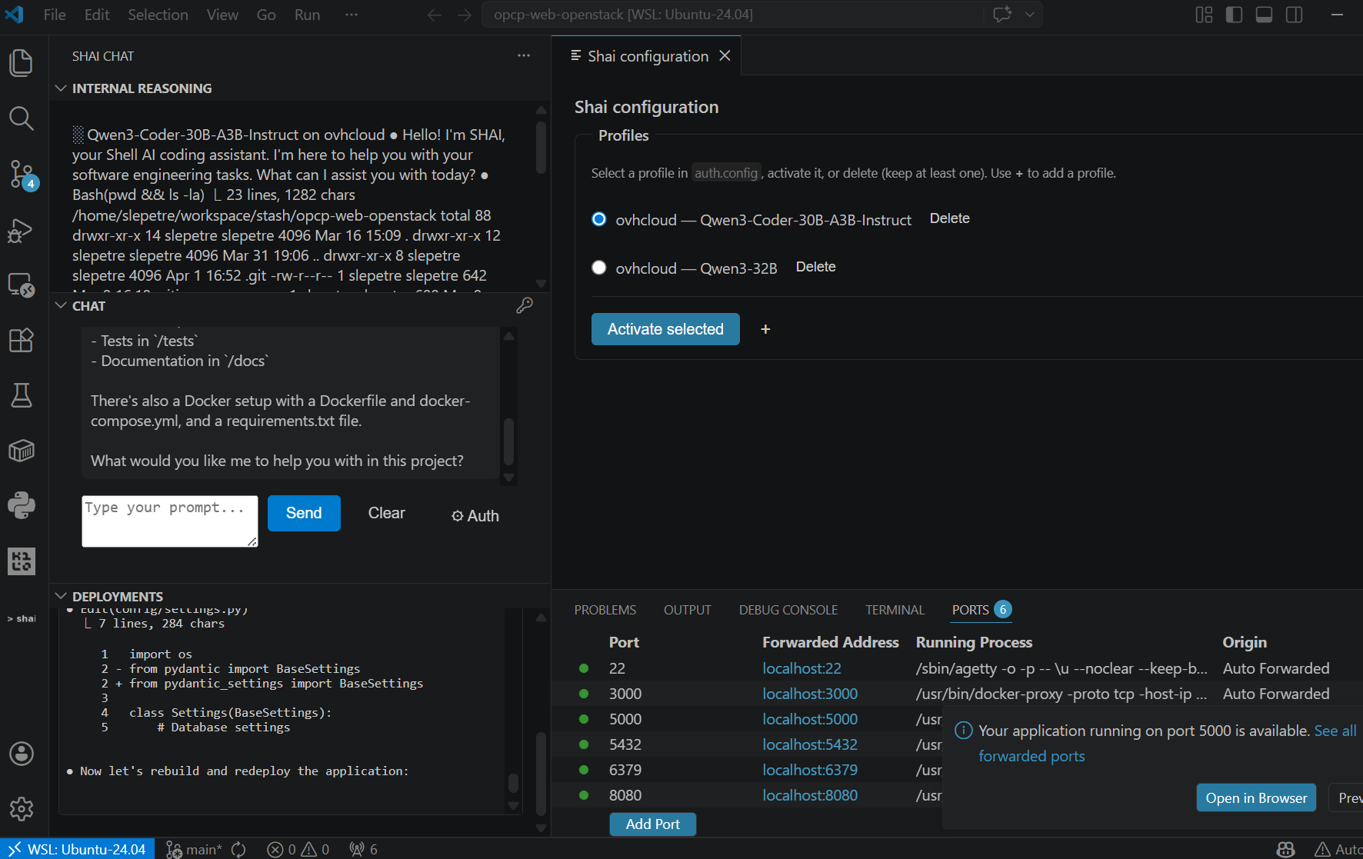


Screenshot
Shai auth
Chat
Deployments

Slide 9
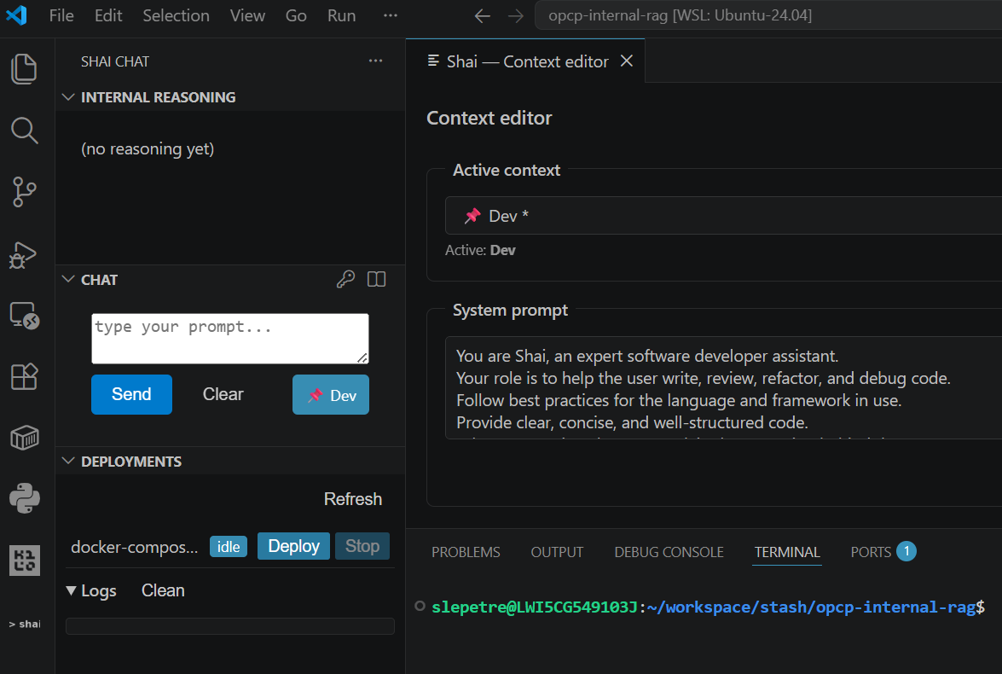
Screenshot
Agents contexts
Contexts:
Dev
Devops
Docker Compose
Spec

Slide 10
DEMO

